Slide 1
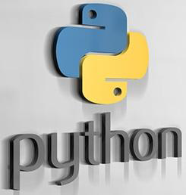

Slide 2
UNIT – IV
Advance Python- OOPs concept
Class and object
Attributes
Inheritance
Overloading and Overriding,
Data hiding.
Regular expressions
Match function
Search function,
Matching VS Searching,
Modifiers Patterns.

Slide 3
Python OOPs Concepts
Like other general purpose languages, python is also an object-oriented language since its beginning. Python is an object-oriented programming language. It allows us to develop applications using an Object Oriented approach. In Python, we can easily create and use classes and objects.
Major principles of object-oriented programming system are given below.
Object
Class
Method
Inheritance
Polymorphism
Data Abstraction
Encapsulation

Slide 4
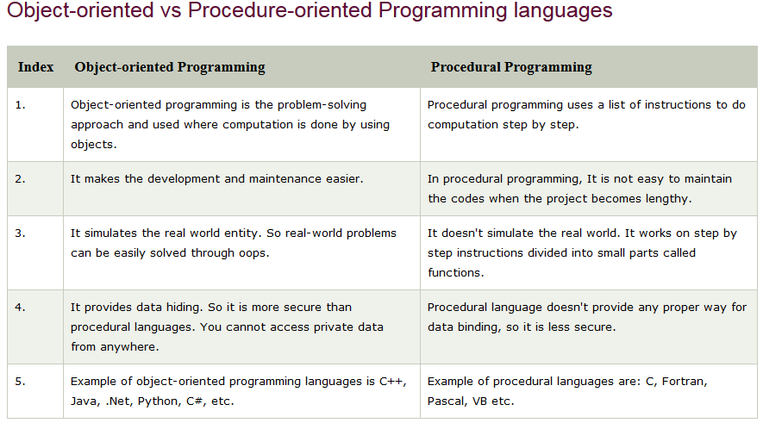

Slide 5
Class:
In python every thing is an object.
To create objects we required some Model or Plan or Blue print, which is nothing but class.
We can write a class to represent properties (attributes) and actions (behaviour) of object.
Properties can be represented by variables
Actions can be represented by Methods.
Hence class contains both variables and methods.
How to Define a class?
We can define a class by using class keyword.
Syntax:
class className:
''' documentation string '''
variables: instance variables, static and local variables
methods: instance methods, static methods, class methods

Slide 6
Documentation string represents description of the class. Within the class doc string is always optional.
We can get doc string by using the following 2 ways.
1. print(classname.__doc__)
2. help(classname)
Within the Python class we can represent data by using variables.
There are 3 types of variables are allowed.
1. Instance Variables (Object Level Variables)
2. Static Variables (Class Level Variables)
3. Local variables (Method Level Variables)
Within the Python class, we can represent operations by using methods. The following are various types of allowed methods
1.Instance Methods
2. Class Methods
3. Static Method

Slide 7
What is Object:
Physical existence of a class is nothing but object.
We can create any number of objects for a class.
Syntax :
reference variable=class name()
Example:
s = Student()
What is Reference Variable:
The variable which can be used to refer object is called reference variable.
By using reference variable, we can access properties and methods of object.

Slide 8
Ex
Class Student:
def __init__(self):
self.name=‘John’
self. age=20
self.marks=900
def talk(self):
print(“Hi, I am”,self.name)
print(“my age is”,self.age)
print(“my marks are”,self.marks)
s=Student()
s.talk()
Output
Hi, I am John
my age is 20
my marks are 900

Slide 9
Self variable:
self is the default variable which is always pointing to current object(like this keyword in Java)
By using self we can access instance variables and instance methods of object.
self should be first parameter inside constructor
def __init__(self):
self should be first parameter inside instance methods
def display(self):
Self is parameter in method and we can use another name inplace of self
def display(my):

Slide 10
Constructor:
Constructor is a special method in python.
The name of the constructor should be __init__(self)
Constructor will be executed automatically at the time of object creation.
The main purpose of constructor is to declare and initialize instance variables.
Per object constructor will be executed only once.
Constructor can take at least one argument(atleast self)
Constructor is optional and if we are not providing any constructor then python will provide default constructor.
Example:
def__init__(self,name,rollno,marks):
self.name=name
self.rollno=rollno
self.marks=marks

Slide 11
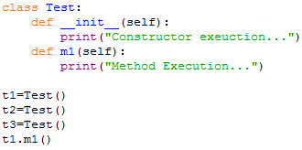

program to demonstrate constructor will execute only once per object:

Slide 12
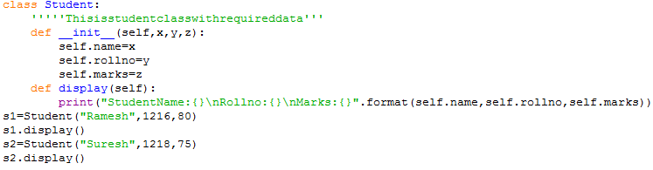
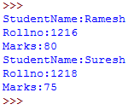

Slide 13
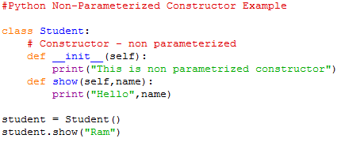

Python Constructor
A constructor is a special type of method (function) which is used to initialize the instance members of the class.
Constructors can be of two types.
Parameterized Constructor
Non-parameterized Constructor

Slide 14
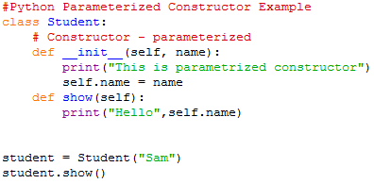


Slide 15
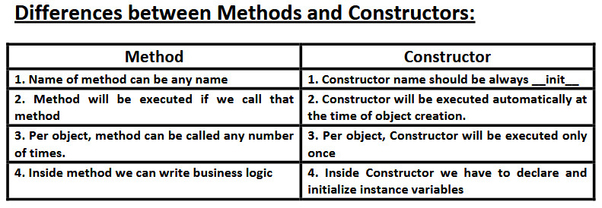

Slide 16
Types of Variables:
Inside Python class 3 types of variables are allowed.
1. Instance Variables(Object Level Variables)
2.Static Variables(Class Level Variables)
3. Local variables (Method Level Variables)
Instance Variables(Object Level Variables):
If the value of a variable is varied from object to object, then such type of variables are called instance variables.
For every object a separate copy of instance variables will be created.
class Student:
def __init__(self,r,n):
self.rno=r
self.name=n
def dis(self):
print(self.rno,self.name)
s1=Student(12,"IT")
s2=Student(3,"Mech")
s1.dis()
s2.dis()

Slide 17
we can declare Instance variables:
1. Inside Constructor by using self variable
2. Inside Instance Method by using self variable
3. Outside of the class by using object reference variable
Example: class Test:
def __init__(self):
self.a=2
self.b=3
def meth(self):
self.c=4
t1=Test()
print("t1's values",t1.__dict__)
t1.d=5
print("t1's values",t1.__dict__)
_dict__ : Dictionary containing the class's namespace.

Slide 18
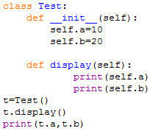

How to access Instance variables:
We can access instance variables with in the class by using self variable and outside of the class by using object reference.

Slide 19
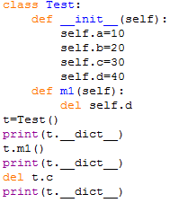

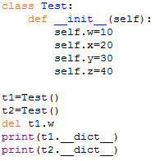

How to delete instance variable from the object:
1. Within a class we can delete instance variable as follows del self.variableName
2. From outside of class we can delete instance variables as follows
del objectreference.variableName
Note: The instance variables which are deleted from one object,will not be deleted from other objects.

Slide 20
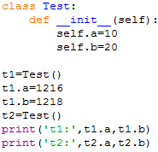

If we change the values of instance variables of one object then those changes won't be reflected to the remaining objects, because for every object we are separate copy of instance variables are available.

Slide 21
2.Static Variables(Class Level Variables):
If the value of a variable is not varied from object to object, such type of variables we have to declare with in the class directly but outside of methods. Such type of variables are called Static variables.
For total class only one copy of static variable will be created and shared by all objects of that class.
We can access static variables either by class name or by object reference. But recommended to use class name.
Instance Variable vs Static Variable:
Note: In the case of instance variables for every object a separate copy will be created, but in the case of static variables for total class only one copy will be created and shared by every object of that class.

Slide 22
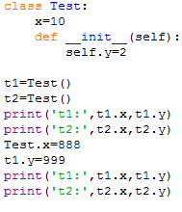

Slide 23
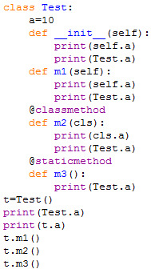
Various places to declare static variables:
1. In general we can declare within the class directly but from out side of any method
2. Inside constructor by using class name
3. Inside instance method by using class name
4. Inside class method by using either class name or cls variable
5. Inside static method by using class name.

Slide 24
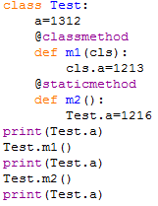

Where we can modify the value of static variable:
Anywhere either with in the class or outside of class we can modify by using classname.But inside class method, by using cls variable.

Slide 25
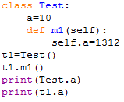

If we change the value of static variable by using either self or object reference variable:
If we change the value of static variable by using either self or object reference variable, then the value of static variable won't be changed, just a new instance variable with that name will be added to that particular object.

Slide 26
How to delete static variables of a class:
We can delete static variables from anywhere by using the following syntax
del classname.variablename
But inside class method we can also use cls variable
del cls.variablename
Note: By using object reference variable/self we can read static variables, but we cannot modify or delete.
If we are trying to modify, then a new instance variable will be added to that particular object.t1.a=16
If we are trying to delete then we will get error.
We can modify or delete static variables only by using classname or cls variable.

Slide 27
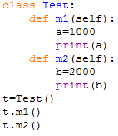

Local variables:
Sometimes to meet temporary requirements of programmer, we can declare variables inside a method directly,
such type of variables are called local variable or temporary variables.
Local variables will be created at the time of method execution and destroyed once method completes.
Local variables of a method cannot be accessed from outside of method.

Slide 28
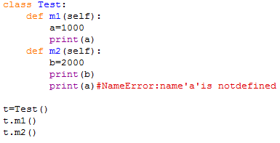
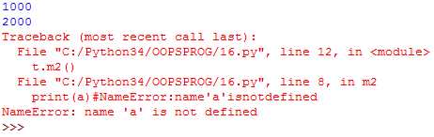

Slide 29
Types of Methods:
Inside Python class 3 types of methods are allowed
1. Instance Methods
2. Class Methods
3. Static Methods
1. Instance Methods:
Inside method implementation if we are using instance variables then such type of methods are called instance methods.
Inside instance method declaration, we have to pass self variable.
def m1(self)
By using self variable inside method we can able to access instance variables.
Within the class we can call instance method by using self variable and from outside of the class we can call by using object reference.

Slide 30
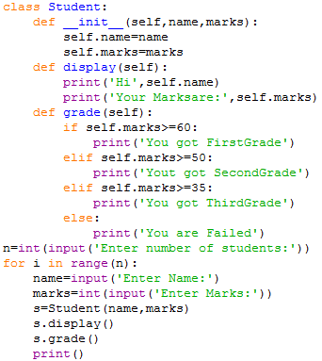
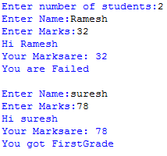

Slide 31
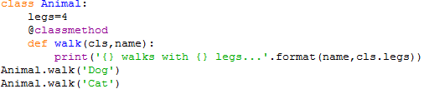

2. Class Methods:
Inside method implementation if we are using only class variables(static variables),then such type of methods we should declare as class method.
We can declare class method explicitly by using @classmethod decorator.
For class method we should provide cls variable at the time of declaration
We can call classmethod by using classname or object reference variable.

Slide 32
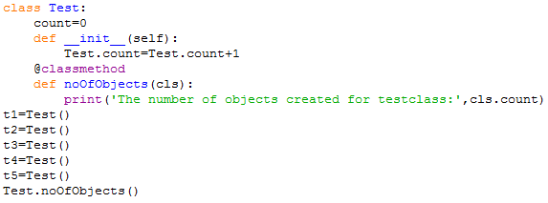

Program to track the number of objects created for a class:

Slide 33
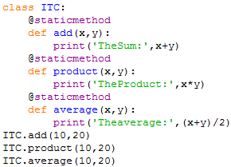

3. Static Methods:
In general these methods are general utility methods.
Inside these methods we won't use any instance or class variables.
Here we won't provide self or cls arguments at the time of declaration.
We can declare static method explicitly by using @staticmethod decorator
We can access static methods by using classname or object reference
Note: In general we can use only instance and static methods.
Inside static method we can access class level variables by using class name.
class methods are most rarely used methods in python.

Slide 34
classmethod() is considered un-Pythonic so in newer Python versions, you can use the @classmethod decorator for classmethod definition.
The difference between a static method and a class method is:
Static method knows nothing about the class and just deals with the parameters
Class method works with the class since its parameter is always the class itself.
the class method is always attached to a class with first argument as the class itself cls.
def classmethod(cls, arg)

Slide 35
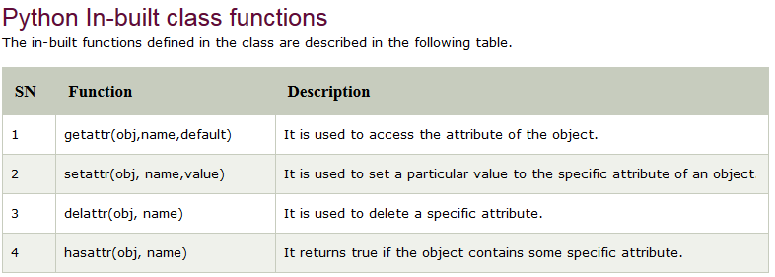

Slide 36
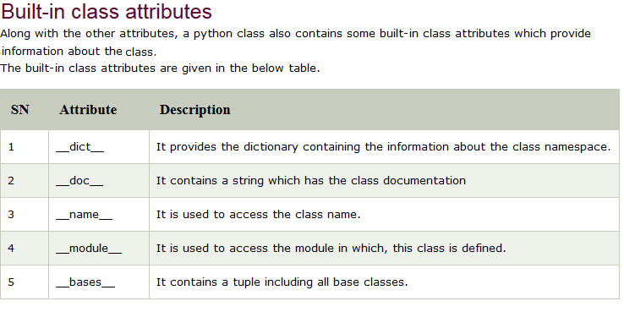

Slide 37
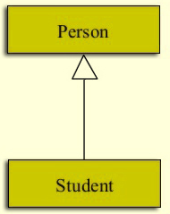
Python Inheritance:
Inheritance is an important aspect of the object-oriented paradigm.
Inheritance provides code reusability to the program because we can use an existing class to create a new class instead of creating it from scratch.
In inheritance, the child class acquires the properties and can access all the data members and functions defined in the parent class.
A child class can also provide its specific implementation to the functions of the parent class.
In python, a derived class can inherit base class by just mentioning the base in the bracket after the derived class name.
Consider the following syntax to inherit a base class into the derived class.
Person can be called any of the following:
Super Class or Parent Class or Base Class
Likewise, Student here is:
Sub Class or Child Class or Derived Class

Slide 38
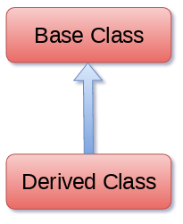

Example:
class A:
# variable of class A
# functions of class A
class B(A):
# variable of class A
# functions of class A
# add more properties to class B

Slide 39
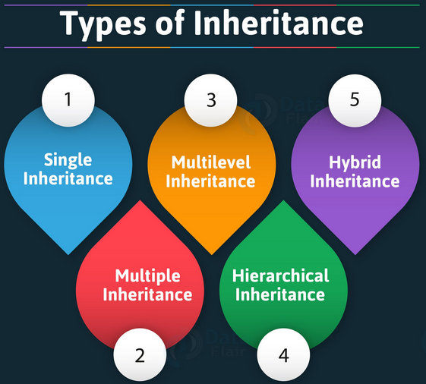

Slide 40
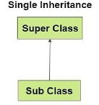
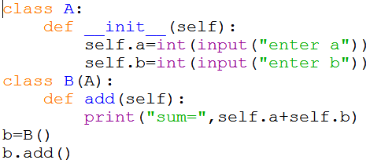

1. Single inheritance: When a child class inherits from only one parent class, it is called as single inheritance.

Slide 41
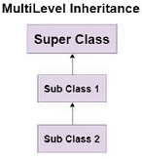
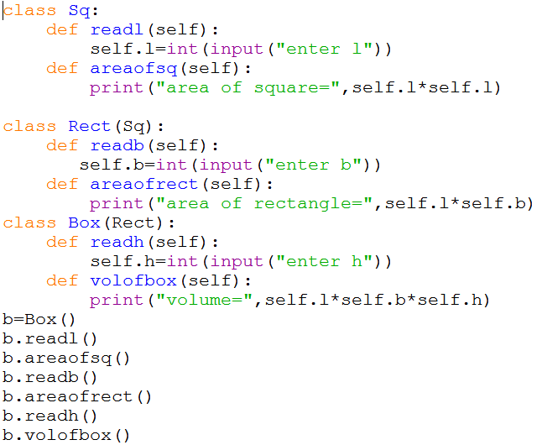
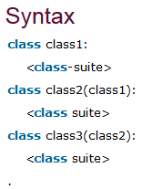
2. Multi-Level inheritance: when a derived class inherits from another derived class.
There is no limit on the number of levels up to which, the multi-level inheritance is archived in python.

Slide 42
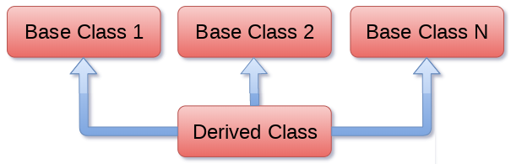
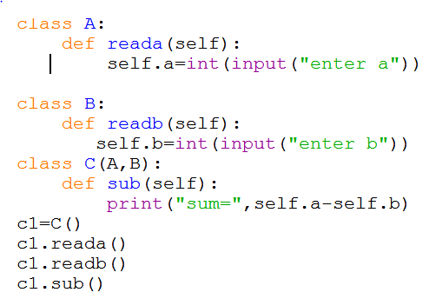
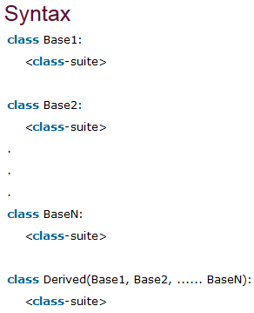
3.Multiple inheritance:
Python provides us the flexibility to inherit multiple base classes in the child class.

Slide 43
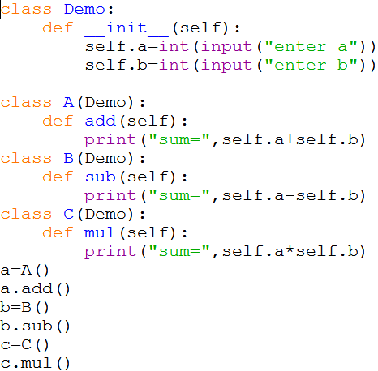
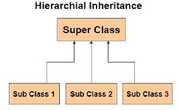
Hierarchical inheritance More than one derived classes are created from a single base.

Slide 44
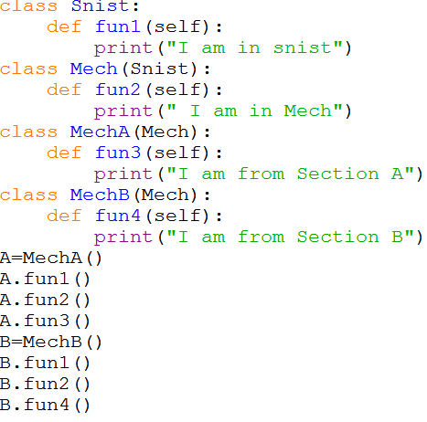
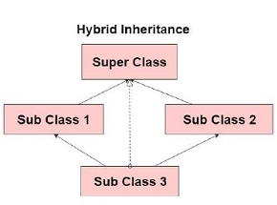
Hybrid inheritance: is combination of more than one form of inheritance. Basically, it is a blend of more than one type of inheritance.

Slide 45
Method Resolution order
In multiple inheritance ,any specified attribute or method is searched first in the current class. If not found ,the search continues into parent classes in depth-first,left to right fashion without searching the same class twice.
class A:
def meth(self):
print(“method in A”)
class B:
def meth(self):
print(“method in B”)
class C:
def meth(self):
print(“method in C”)
class X(A,B):
def meth(self):
A.meth(self)
B.meth(self)
print(“method in X”)
class Y(B,C):
def meth(self):
B.meth(self)
C.meth(self)
print(“method in Y”)
class P(X,Y,C):
def meth(self):
X.meth(self)
Y.meth(self)
C.meth(self)
print(“method in P”)
P1= P()
P1.meth()

Slide 46
Polymorphism:
Poly means many. Morphs means forms.Polymorphism means 'Many Forms'.
variable, object or a method exhibits different behavior in different contexts is called polymorphism
Eg1:+ operator acts as concatenation and arithmetic addition
print(10+20)#30
print(‘Sree'+‘nidhi')#Sreenidhi
Eg2:* operator acts as multiplication and repetition operator
`print(10*20)#200
print(‘snist'*3)#snistsnistsnist
Eg3:We can use deposit() method to deposit cash or cheque or dd
deposit(cash)
deposit(cheque)
deposit(dd)
1.Operator Overloading
2.Method Overloading
3.Method overriding

Slide 47
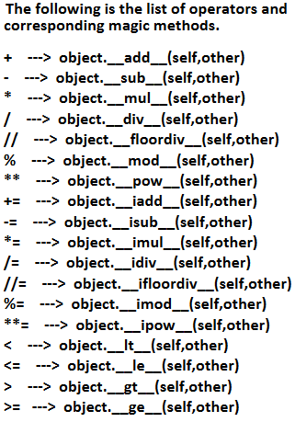

Operator overloading:We can use the same operator for multiple purposes, which is nothing but operator overloading.
* operator can be used for multiplication and string repetition purposes.
Python supports operator overloading.+ operator can be used for Arithmetic addition ,complex addition , String concatenation and combine two lists.But + operator can not add two objects.
We can overload +,*,-…etc operators to act upon objects using special methods

Slide 48
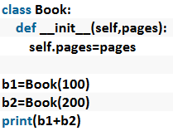
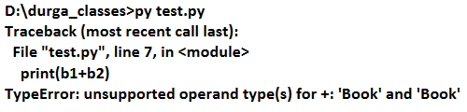

Slide 49
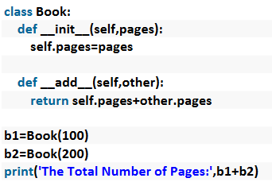
We can overload + operator to work with Book objects also. i.e
Python supports Operator Overloading.
For every operator Magic Methods are available.
To overload any operator we have to override that Method in our class.
Internally + operator is implemented by using __add__() method.
This method is called magic method for + operator.
We have to override this method in our class.

Slide 50
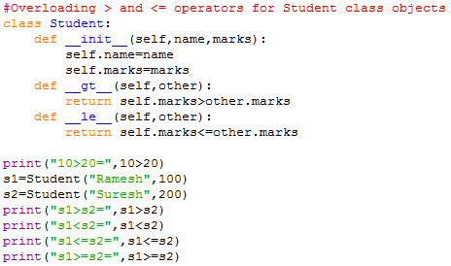
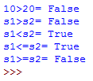

Slide 51
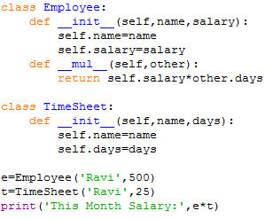


Slide 52
Method Overloading:
Defining multiple methods having same name but different type of arguments then those methods are said to be overloaded methods.
class X:
def product(self,a,b):
print(a*b)
def product(self,a,b,c):
print(a*b*c)
X1=X()
X1.product(4,5) # produces an error
But in Python Method overloading is not possible.
If we are trying to declare multiple methods with same name and different number of arguments then Python will always consider only last method.
But we can make the same function work differently using Default arguments and Variable length arguments
In python, If single method can perform more than one task is called method overloading

Slide 53
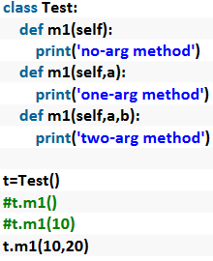

class addition
def add(self,x=10,y=20)
print(a+b)
a1=addition()
a1.add()
a1.add(20)
a1.add(30,40)
a1.add(“hello”,”snist”)
a1.add(23.5,56.2)
a1.add([11,12],[34,45])

Slide 54
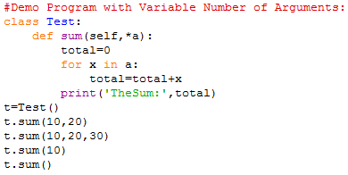


Slide 55

Constructor Overloading:
Constructor overloading is not possible in Python.
If we define multiple constructors then the last constructor will be considered.
In the above program only Two-Arg Constructor is available.
But based on our requirement we can declare constructor with default arguments and variable number of arguments.

Slide 56



Slide 57



Slide 58


Method overriding: defining same method with same number of arguments in both super class and sub class is called method overriding
What ever members available in the parent class are by default available to the child class through inheritance.
If the child class not satisfied with parent class implementation then child class is allowed to redefine that method in the child class based on its requirement. This concept is called overriding.
Overriding concept applicable for both methods and constructors.

Slide 59
Super() method
If we write a method or constructor in the sub class with exactly same name as that of super class method or constructor, it will override super class method or constructor
super class method and constructor are not available to the sub class, only sub class method and constructor are accessible from the sub class object.
Super() is a built in method which is useful to call the super class constructor or methods from the base class.
super().__init__() #call super class default constructor
super().__init__(arguments) #call super class parameterized constructor
super().method() #call super class method
We can use super class name to call super class constructor or method
super class name.__init__(self) #call super class default constructor
super class name. __init__(self,argument) #call super class parameterized constructor
super class name.method(self) #call super class method

Slide 60


From Overriding method of child class, we can call parent class method also by using super() method.
class square:
def __init__(self):
self.a=int(input(“enter side”))
def area(self):
print(“area of square=“,self.a**2)
class rectangle(square):
def __init__(self):
super().__init__()
self.b=int(input(“enter other side”))
def area(self):
super().area()
print(“area of rectangle”,self.a*self.b)
r=rectangle()
r.area()

Slide 61

In the above example, if child class does not contain constructor then parent class constructor will be executed From child class constructor we can call parent class constructor by using super() method.

Slide 62



Slide 63
Data hiding
Abstraction is an important aspect of object-oriented programming.
In python, we can also perform data hiding by adding the double underscore (___) as a prefix to the attribute which is to be hidden.
After this, the attribute will not be visible outside of the class through the object.
Ex
class My class:
def __init__(self):
self.__y=3
m=Myclass()
print(m.y) # produces an error ie; Attribute Error

Slide 64
Regular expressions
A Regular Expression is a string that contains symbols and characters to find and extract the information needed by us. A Regular expression helps us to search information, match, find and split information as per our requirements.
It is also called regex.
The Regular Expressions are used to perform the following operations.
Matching strings
Searching for strings
Finding all strings
Splitting a string into pieces
Replacing strings
python provides re module, it contains the methods like compile(), search(), match(), findall(), split() etc are used in finding the information in the available data.so when we write regular expressions, we should import re module
The string is prefixed with r or R is called raw string
str=r“hello \n snist”
print(str) #hello \n snist
If regular expressions should written as raw strings, the normal meaning of escape characters(\n,\t,\v,\b,\’…) are escaped .The escape characters interpreted as special characters in the regular expression.
pat=r‘\b a\w* \b \\ raw string
If we do not want to write the regular expressions as raw strings, then use another backslash before escape characters.
pat=‘\\b a\w* \\b \\ normal string

Slide 65
MetaCharacters: metacharacters are used to specify regular expressions
Metacharacters are characters that are interpreted in a special way by a RegEx engine. Here's a list of metacharacters: * + ? . [] ^ $ {} () \ |
Quantifiers
Character Description
* Zero or more occurrences of the preceding expression
+ one or more repetitions of the preceding expression
? Zero or one repetition of the preceding expression
{m} Exactly m occurences
{m,n} from m to n occurrences( m defaults to 0, n to infinity)
{m,} At least m occurrences
Special characters
. Matches any character except new line
[…] set of possible characters.
[^…] matches every character except the ones inside brackets
^ check if a string starts with a certain character or word
$ check if a string ends with a certain character or word
\ escape special characters nature
(…) matches the regular expression inside the parenthesis
R|S matches either regex R or regex S

Slide 66

We can develop Regular Expression Based applications by using python module: re
This module contains several inbuilt functions to use Regular Expressions very easily in our applications.
compile()
re module contains compile() function to compile a pattern into RegexObject.(Python Object)
pattern = re.compile("ab")

Slide 67


finditer():
Returns an Iterator object which yields Match object for every Match.
We can check how many matches are available.
matcher = pattern.finditer(“Python is very is easy")
On Match object we can call the following methods.
1. start()→Returns start index of the match
2. end() →Returns end+1 index of the match
3. group() →Returns the matched string

Slide 68



Slide 69
Quantifiers:
We can use quantifiers to specify the number of occurrences to match.
a→ Exactly one 'a‘
A+→ Atleast one 'a‘
a*→Any number of a's including zero number
a?→Atmost one 'a' i.e. either zero number or one number
a{m}→Exactly m number of a's
a{m,n}→Minimum m number of a's and Maximum n number of a's

Slide 70







Slide 71


Slide 72







Slide 73






Slide 74
Sequence characters in Regular Expressions
Character Description
\d represents any digit([0-9])
\D represents any non digit([^0-9])
\s represents white space[ \t\n\r\f\v].)
\S represents non whitespace [ ^\t\n\r\f\v].)
\w represents any alphanumeric([A-Za-z0-9_])
\W represents any non alphanumeric([^A-Za-z0-9_]
\b represents a space around words
\A matches only at start of the string
\z matches only at end of the string

Slide 75






Slide 76
Important functions of re module:
compile()
match()
search()
findall()
sub()
subn()
split()
fullmatch()
finditer()

Slide 77



1. match():
We can use match function to check the given pattern at beginning of target string.
If the match is available then we will get Match object, otherwise we will get None.

Slide 78



Slide 79
2. search():
We can use search() function to search the given pattern in the target string.
If the match is available then it returns the Match object which represents first occurrence of the match.
If the match is not available then it returns None

Slide 80


3. findall():
To find all occurrences of the match.
This function returns a list object which contains all occurrences.

Slide 81



Slide 82

4. sub():
sub means substitution or replacement
re.sub(regex,replacement,target string)
In the target string every matched pattern will be replaced with provided replacement.

Slide 83


5. subn():
It is exactly same as sub except it can also returns the number of replacements.
This function returns a tuple where first element is result string and second element is number of replacements.
(resultstring, number of replacements)

Slide 84




6.split():
If we want to split the given target string according to a particular pattern then we should go for split() function.
This function returns list of all tokens.

Slide 85


7. fullmatch():
We can use fullmatch() function to match a pattern to all of target string. i.e. complete string should be matched according to given pattern.
If complete string matched then this function returns Match object otherwise it returns None.

Slide 86


8. finditer():
Returns the Iterator yielding a match object for each match.
On each match object we can call start(),end() and group() functions.

Slide 87
Matching Versus Searching
Python offers two different primitive operations based on regular expressions: match checks for a match only at the beginning of the string, while search checks for a match anywhere in the string

Slide 88


^ symbol:
We can use ^ symbol to check whether the given target string starts with our provided pattern or not.

Slide 89

$ symbol:
We can use $ symbol to check whether the given target string ends with our provided pattern or not

Slide 90



Slide 91

Regular Expression Modifiers: Option Flags
Regular expression literals may include an optional modifier to control various aspects of matching. The modifiers are specified as an optional flag. You can provide multiple modifiers using exclusive OR (|), as shown previously and may be represented by one of these −
Flags Description

